Slide 1
MP-1 Quad UAV
Group 2C - Vignesh Krishnan, Amith KVB, Archit Joshi

Slide 2
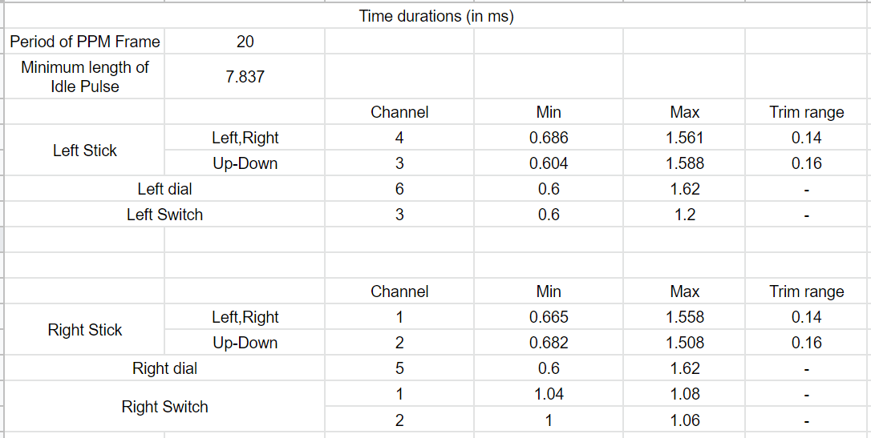
Humble Beginnings

Slide 3
Creating State Machines
Started with testing in ModelSim
Switched from ModelSim to Vivado testbench
Lots of VHDL conceptual misunderstandings
Synchronous vs. Asynchronous processes
Driving same signal in multiple processes
Latches
Sensitivity lists

Slide 4
Major Roadblocks
Debouncing signal
Port mapping and AXI_PPM component structure
Reading and writing slave registers
Infinite counter: 42 second delay for output
Calculating idle value vs. getting idle count from capture

Slide 5
Debugging Methods
Porting register values to slave and printing on Putty
Making sure hardware actually updated from bitstream
Latch warnings in Vivado
First completing and testing capture, then testing generate

Slide 6
Casualties
Finished last minute, so software filter mode not completed
Didn’t have a chance to test on drone
Thought we started early; can never start early enough
This MP destroyed us mentally, can’t wait for the next one

